Slide 1

Medical Review: Predicting Outcomes
Kimberly Hall-Martin
Bellevue University
DSC 680
Notes:
Introductions

Slide 2
Introduction
Data from the California Department of Managed Healthcare (DMHC).
DMHC puts together teams of providers to perform Independent Medical Reviews (IMR).
IMR happen when a health plan denies a patient’s claim.
IMR team goes through each claim, and makes the final decision to uphold or overturn the decision of the health plan.
IMR decides to overturn the health plan’s decision (i.e. agree with the patient), the health plan must go back and approve the treatment for the patient (Kaggle).
Allows for checks and balances within the health care system and can be beneficial to enrollees within healthcare plans.
Notes:
This dataset was originally from the California Department of Managed Healthcare (DMHC). DMHC puts together teams of providers to perform Independent Medical Reviews (IMR). IMR happen when a health plan denies a patient’s claim. The IMR team is then given the task of going through each claim, and making the final decision to uphold or overturn the decision of the health plan. If the IMR decides to overturn the health plan’s decision (i.e. agree with the patient), the health plan must go back and approve the treatment for the patient (Kaggle). This allows for checks and balances within the health care system and can be beneficial to enrollees within healthcare plans.

Slide 3
Goals
States unable to create teams of sophisticated and knowledgeable doctors to perform medical reviews of insurance claims that have been denied.
Run the risk of human bias influencing decisions.
Create a text classification model
Bring unbiased medical review services to all states
Give a fair chance of approval to people enrolled in health plans
Notes:
The problem at stake is that many states are unable to create a team of sophisticated and knowledgeable doctors to perform medical reviews of insurance claims that have been denied. Even if they are, you run the risk of human bias influencing decisions. The goal is to create a text classification model that will ultimately be able to bring unbiased medical review services to all states and give a fair chance of approval to people enrolled in health plans.

Slide 4
Targeted Audience
Leaders within government
Leaders of Health Insurance Companies
Those interested in promoting a fair and efficient way of handling medical claims

Slide 5
Data Preparation
Fairly clean and balanced,
Cleaning the text
Taking out line breaks, punctuation and capital letters.
Label coder
Decision feature a numeric labeling system
Overturned decision was labeled as 0 and an upheld decision was labelled as 1.
Split into train and test sets
Notes:
This data was fairly clean and balanced, making it good for model training. The data did need some preprocessing. Cleaning the text involved taking out line breaks, punctuation and capital letters. A label coder was also applied to give the Decision feature a numeric labeling system. An overturned decision was labeled as 0 and an upheld decision was labelled as 1. The data also needed to be split into train and test sets in order to train them to the model.

Slide 6
Tools Used
Term Frequency-Inverse Document Frequency (TF-IDF) vectorization
TF-IDF is used to measure the importance of a word amongst a group of other words in documents.
Words with more relevance get a higher value
Logistic Regression
Confusion matrix
Visual to represent the performance of the classification model
Bar chart to visualize important words that affect the decision being made.
Based off of their coefficient weights from the logistic regression model trained on TF-IDF features.
If a word leans more toward “upheld” it gets a positive coefficient, and if it leans more toward overturned, it gets a negative coefficient.
Notes:
The methods being used for Natural Language Processing (NLP) text classification of these medical reviews are Term Frequency-Inverse Document Frequency (TF-IDF) vectorization, and logistic regression for model training. TF-IDF is used to measure the importance of a word amongst a group of other words in documents. Words with more relevance get a higher value (GeeksforGeeks). A confusion matrix was used as a visual to represent the performance of the classification model. A bar chart was created to visualize important words that affect the decision being made. These words were based off of their coefficient weights from the logistic regression model trained on TF-IDF features. If a word leans more toward “upheld” it gets a positive coefficient, and if it leans more toward overturned, it gets a negative coefficient.

Slide 7
Evaluation Methods
Accuracy
Precision
Recall
F1-Score
Notes:
The analysis of this data set showed many things. To measure how well the logistic regression model predicted whether a medical review was upheld or overturned accuracy, precision, recall and F1-score were used to evaluate performance. A score of 95% was received for accuracy, which means 95% of the time the model correctly classified. Regarding precision the model was correct at choosing upheld 95% of the time and correct at choosing overturned 94% of the time. The model scored the same for recall, out of all the decisions the model caught 95% of upheld and 94% of overturned. Finally, the F1 scores, which measure the balance of precision and recall, were evaluated. Both decision classes scored 94% or higher.

Slide 8
Conclusions
After reviewing the performance metrics, it is determined that the logistic regression model was a good fit for the data.
The high F1 and accuracy scores especially signify that the model is balanced.
Neither decision class is underperforming and causing noise in our model.
This leads us to believe that there are plenty of words and/or phrases that can signal what the review outcome might be.
Notes:
After reviewing the performance metrics, it is determined that the logistic regression model was a good fit for the data. The high F1 and accuracy scores especially signify that the model is balanced. Neither decision class is underperforming and causing noise in our model. This leads us to believe that there are plenty of words and/or phrases that can signal what the review outcome might be.

Slide 9
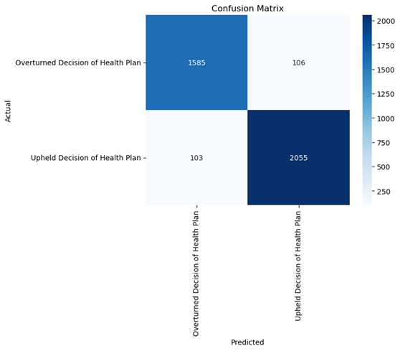
Confusion Matrix
Provides a visual of how well the classification model performed.
For actual overturned results, the model predicted overturned 1,585 times and incorrectly predicted 106 times.
For upheld results, the model predicted upheld 2,055 time and incorrectly predicted 103 times.
Notes:
The confusion matrix (Image 1) provides a visual of how well the classification model performed. For actual overturned results, the model predicted overturned 1,585 times and incorrectly predicted 106 times. For upheld results, the model predicted upheld 2,055 time and incorrectly predicted 103 times.

Slide 10
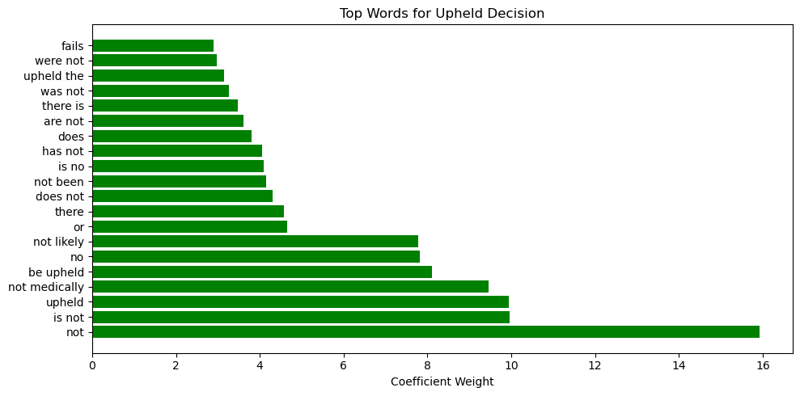
Important Words: Upheld Decision
Notes:
The visualization of important words (Image 2 and 3) tells us which words push the model more towards a certain decision. Words with high positive weight lean more towards predicting “upheld” and those with high negative weight lean more toward predicting “overturned”. The top 4 words determining if a decision is upheld are “not”, “is not”, “upheld” and “not medically”. This makes sense because most treatments that are not medically necessary will be denied

Slide 11
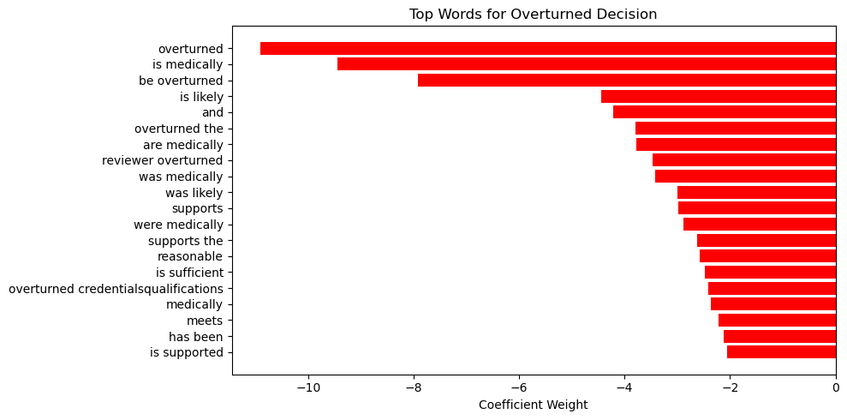
Important Words: Overturned Decision
Notes:
. The top 4 words determining if a decision is overturned are “is supported”, “has been”, “meets” and “medically”. These words also align with what you would think because assumedly a medically necessary treatment would be covered.

Slide 12
Recommendations
Take this model and create medical review teams that can accurately and efficiently review denied medical claims.
To implement this plan, it is recommended to work with each state’s medical decision group
Decision data should continually be collected in order keep the model well trained and up to date on current words and phrases being used.
Ethical Considerations
Medical data
Assumed that this dataset complies with all HIPPA laws.
Outcome of this text classification are impacting real life people and their health
This should not be taken lightly. Before implementation, this model needs to be tested thoroughly.
Notes:
Recommendations would be to take this model and create medical review teams that can accurately and efficiently review denied medical claims. To implement this plan, it is recommended to work with each state’s medical decision group, that equivalent of the DMHC in California. Decision data should continually be collected in order keep the model well trained and up to date on current words and phrases being used.
Some ethical considerations are that this is medical data. It is assumed that this dataset complies with all HIPPA laws. It also needs to be considered that the outcomes of this text classification are impacting real life people and their health. This should not be taken lightly. Before implementation, this model needs to be tested thoroughly.

Slide 13
Q&A

Slide 14
References
The medical review data set was obtained from Kaggle
https://www.kaggle.com/datasets/prasad22/ca-independent-medical-review/data
GitHub Link for Code
https://github.com/kimhall1/Medical-Review-Predicting-Outcomes-Project-3
GeeksforGeeks. (2025, February 7). Understanding TF-IDF (Term Frequency-Inverse Document Frequency). https://www.geeksforgeeks.org/machine-learning/understanding-tf-idf-term-frequency-inverse-document-frequency/

